Slide 1

BI PROJECT
Customer Churn Analysis

Slide 2
Problem
The leading telecom company has a massive market share but one big problem: several rivals that are constantly trying to steal customers.
Company executives have decided to focus on their churn: the rate at which they lose customers. Churn rate is a measure of the number of customers moving out of a collective group over a specific period. It is one of two primary factors that determine the steady-state level of customers a business will support.
The different stakeholders impacted by the problem are:
the marketing team, the customer service team and the customers.
Because this company has been the market leader for so many years, there are not significant opportunities to grow with new customers. It is a very important problem because that hurts the valuation of the company, that indicates also that something is failing in your customer relationships.
If the churns continue that can jeopardize the company’s future.

Slide 3
Methodology
The marketing team wants to find out who the most likely people to churn are and create content that suits their interests. The customer service team would like to proactively reach out to customers who are about to churn, and try to encourage them to stay. Retention cost is always less than customer acquisition cost. Respond to those questions can help to figure out how to retain customers who might leave but have not yet left, and could save a substantial amount of money.
A dataset of 7,000 customers for the past month has been provided. This dataset contains information regarding telecom subscribers. Based on this information, we will build a model to identify customers who are most likely to leave the network to some other service provider.

Slide 4
Methodology
The data set includes information about:
Customers who left within the last month – the column is called Churn
Services that each customer has signed up for – phone, multiple lines, internet, online security, online backup, device -protection, tech support, and streaming TV and movies.
Customer account information – how long they’ve been a customer, contract, payment method, paperless billing, monthly charges, and total charges.
Demographic info about customers – gender, age range, and if they have partners and dependents.

Slide 5
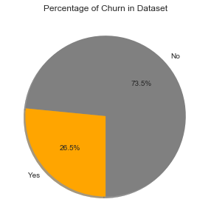
Results
The percentage of Churn Customers is 26.537% and customers that keep in with the active services is 73.463%.

Slide 6
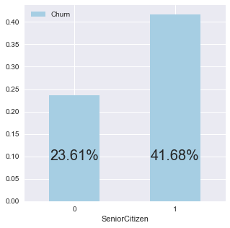
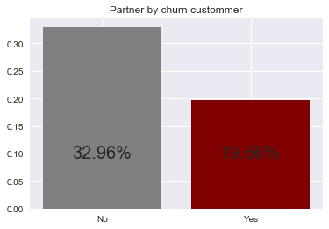
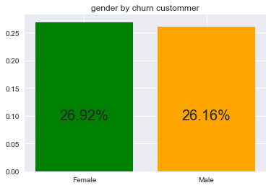
Results
Distribution of Customer demographics by churn customer

Slide 7
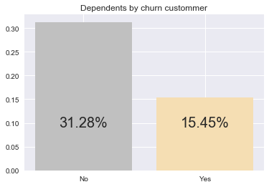
Results
With those graphics above we can see:
Senior citizens are most to Churn than Younger, 23.61% of Younger Churn among 41.68% of Senior
Yes it's true female customers are more likely to churn, but the difference is minimal (~0.8%)
19.66% of customer who have Partner Churn, beside 32.96% Whose don't have
31.28% of no dependents customer Churn, beside 15.45% dependents customer

Slide 8
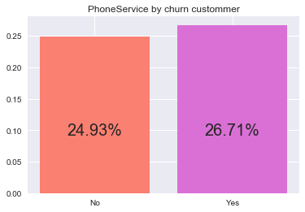
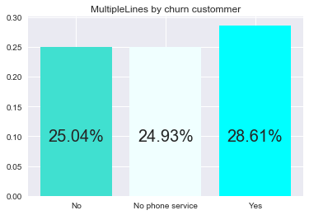
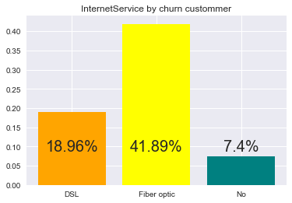
Results
Distribution of customer Services used by churn customer

Slide 9
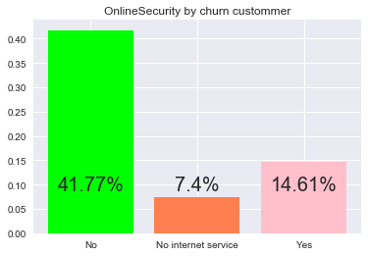
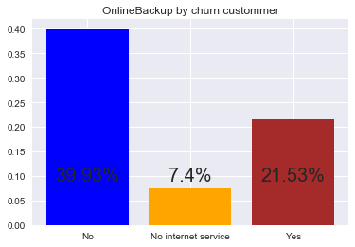
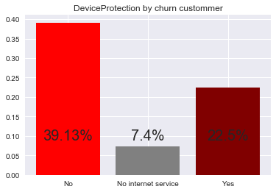
Results
Distribution of customer Services used by churn customer

Slide 10
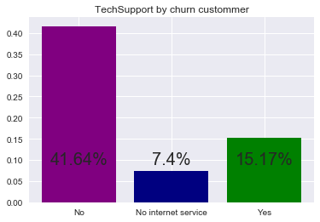
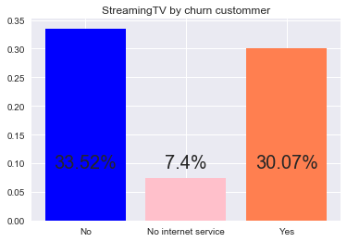
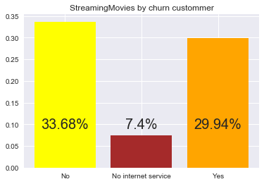
Results
Distribution of customer Services used by churn customer

Slide 11
Results
There are 26.71% of people that use a phone service Who Churn beside 24.93% that not use it. The difference is not really significant
It seems that there are more people that use a multiple lines service who Churn : then 28.61%, though no great difference
People that use a fiber optic are more to Churn, there are 41.9% of customer that use fiber optic as internet service who churn.
41.77% of customer who don't use a online security are churn customer
39.93% of customer who don't use an online backup are churn customer
Customer who don't use an device protection are more to churn, 39.13% of customer who don't use an device protection churn
Customer who don't have the service of tech Support are more to churn , 41.64% of customer who don't have an tech support are churn customer.
Customer who not use streaming TV are more to churn than customer who use it, though the difference is not really great, 33.52% and 30.07 respectively
customer who not use streaming Movies are more to churn than customer who use it, though the difference is not really great, 33.68% and 29.44% respectively

Slide 12
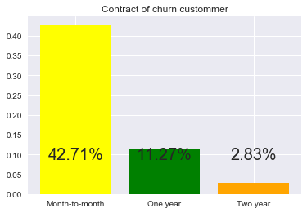
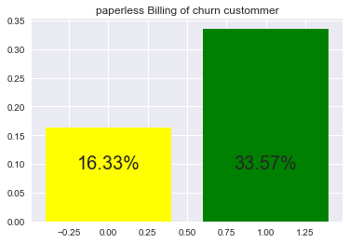
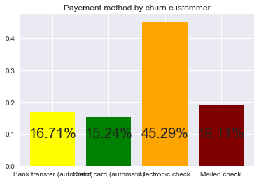
Results
Distribution of customer Billing information by churn customer

Slide 13
Results
42.71% of customer that have an contract of month to month are churn customer, a people that have an contract of two years are less to churn, which is understandable.
33.57% of customer who use paperless Billing are churn customer
we can see now 45.29% of customer who use electronic check as payment method are churn custommer

Slide 14
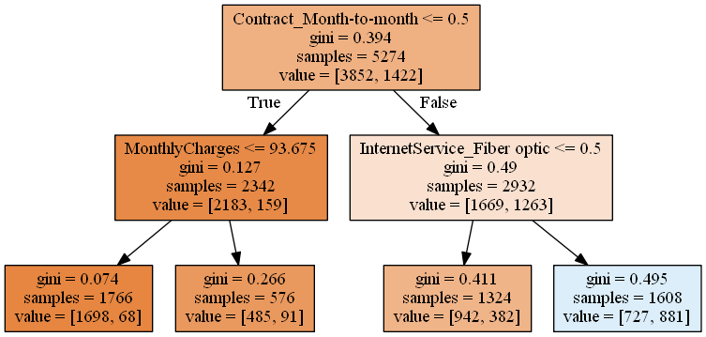
Result
Based on my model of decision tree we can see ‘“ContractMonth-to-month’ has a real impact on our predicted variable, which means that customers with this type of contract are very likely to churn. Also we can see customer that use fiber optic as internet service are very likely to churn.

Slide 15
Discussion & Recommendations
Finally we found that the profile type of churn customer is a customer more likely to be a senior, male or female, more likely to have a month to month contract, more likely to not use any service or to use only a phone service and have an fiber optic as internet service , to that point I don’t really look deeper but we can theorize that maybe the fiber optic it’s really expensive so that have increased considerably the monthly charges and Total charges. In that case perhaps there are other company that provide it more affordable.
For recommendations, fist of all the company has to provide more reasons to the customer to have a contract of one to two years instead of an month to month contract. The team marketing must to work hardly in order to push customers to use the different services of the company. Furthermore perhaps the company has to look at fiber optic services offered by competitors in order to adjust to avoid customer to go elsewhere.

Slide 16
Discussion & Recommendations

Slide 17
References & Appendices
https://github.com/B1o0b1/Customer-Churn-Analysis
https://www.bullhorn.com/blog/2016/09/4-ways-customer-churn-hurts-business/
By: Jean Franco Chosson

